Slide 1
Overview of Testing for Lead in School Drinking Water
Office of School Facilities Planning
Division of Finance and Business Services
December 2021

Slide 2
NJDOE Regulations
N.J.A.C. 6A:26-12.4 Safe Drinking Water (July 13, 2016) requires testing in all drinking water outlets.
Initial testing completed by July 13, 2017
Testing required beginning on July 1, 2021 and completed by June 30, 2022.
Subsequently from July 1, 2024 to June 30, 2025
Testing required after any plumbing repairs or new construction
https://www.nj.gov/education/lead/

Slide 3
https://www.nj.gov/education/lead/

Slide 4
Why Testing is Important
Lead is a toxic metal that is harmful to human health.
Children and pregnant women most susceptible
Reduced IQ and attention span, learning disabilities, impaired growth and hyperactivity
No safe blood level in children (EPA and CDC)
Affects almost every organ and system in the body
https://www.cdc.gov/nceh/lead/

Slide 5
Sources of Lead in Drinking Water
Lead in drinking water is typically from the following:
Lead piping
Lead solder (used until 1988)
Fittings, valves and
Fountains and faucets
Note: Requirement of “lead free” plumbing changed from 8% to 0.25% (weighted average) in 2014.
Testing is the best way to find out if lead is in the drinking water!

Slide 6
Federal Drinking Water Regulations
Safe Drinking Water Act (SDWA) Lead Ban (1986) - “lead free”
Lead Contamination Control Act (LCCA) (1988)
Lead and Copper Rule (1991)
Reduction of Lead in Drinking Water Act (2011)
USEPA 3Ts for Reducing Lead in Drinking Water in Schools: https://www.epa.gov/ground-water-and-drinking-water/3ts-reducing-lead-drinking-water

Slide 7
NJDOE Requirements
What is required from
state funded childcare centers?

Slide 8
NJDOE Regulations
Who is required to test for lead in drinking water?
All New Jersey public school districts;
Charter schools;
Renaissance schools;
Jointure commissions;
Educational services commissions;
Approved Private Schools for Students with Disabilities;
State Funded Early Childhood Centers; and
Receiving schools as defined by N.J.A.C. 6A:14:7.1(a)

Slide 9
State Funded Childhood Centers
How to schedule lead testing for drinking water?
NJDCF will be in contact with early childcare facilities. If the center has not yet been contacted by representatives from NJDCF, reach out using the email address below.
2021-2022 Testing is being funded through NJDCF Water Infrastructure Improvements for the Nation (WIIN) Act grant
For more information email NJDCF’s Office of Licensing (OOL) at DCF.CCLEnvironmental@dcf.nj.gov

Slide 10
Statement of Assurance (SOA)
By June 30th of every year, state funded childcare centers must submit an SOA to the NJDOE affirming:
Testing for lead in drinking water was completed (if during a testing year);
Test results are posted on the center’s or school district’s website;
Notifications were provided as appropriate;
The NJDOE must be notified if any sample exceeds the action level of 15 ppb.
Alternate drinking water is provided if the lead sampling exceeds the action level (15 ppb).

Slide 11
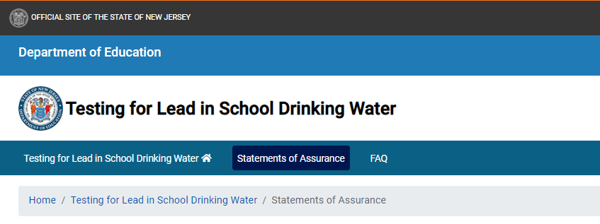
Where are the SOAs found?
On the NJDOE website: Statements of Assurance (nj.gov)

Slide 12
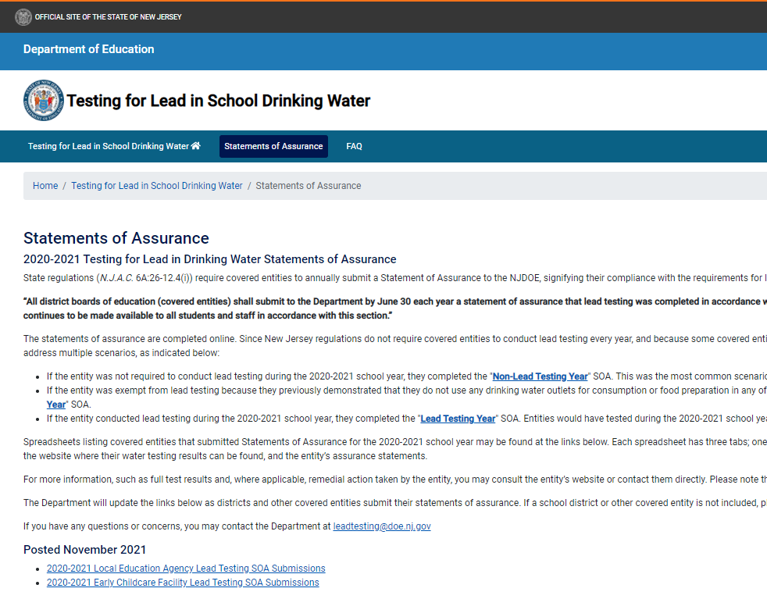
Bottom of the Statements of Assurance Page

Slide 13
Bottom of the Statements of Assurance Page

Slide 14
GardenStateAcademyTestResults

Slide 15
Exemption from lead testing
Exempt if no drinking water outlets are used for consumption or for food preparation
Must submit an exemption application (NJDOE Exempt from Drinking Water Testing Application). Our office reviews the application and sends an approval letter.
Approval letters must be available on the center’s website.
Must reapply for an exemption, or begin testing, every designated Statewide testing year.
An SOA is required to be submitted by June 30th of each year.

Slide 16
Important Links
New Jersey Department of Education (NJDOE) Testing for Lead in Drinking Water: https://www.nj.gov/education/lead/
Questions or comments for NJDOE: email leadtesting@doe.nj.gov
New Jersey Department of Environmental Protection (NDEP) Guidance Documents: https://www.state.nj.us/dep/watersupply/schools.htm

Slide 17
Thank You!
New Jersey Department of Education: nj.gov/education
Brian Salvo Louisa Soto
Environmental Scientist 3 Government Representative 2
Office of School Facilities Planning Field Support and Services
New Jersey Department of Education New Jersey Department of Education
Contact at leadtesting@doe.nj.gov
Follow Us!
Facebook: @njdeptofed
Twitter: @NewJerseyDOE
Instagram: @NewJerseyDoe

